Slide 1
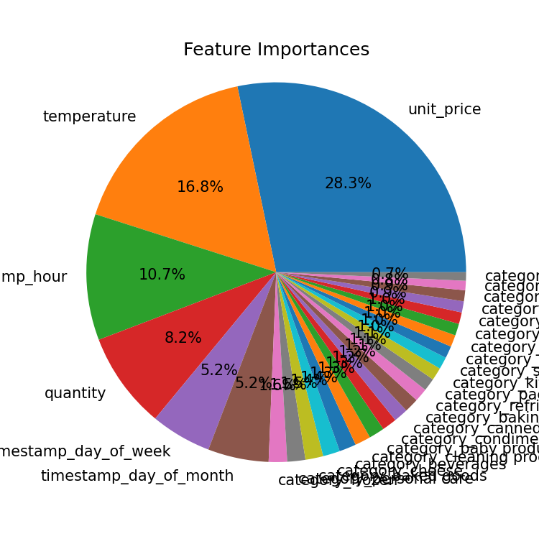
Model Building and Interpretation
Feature Importance:
Price: Significantly impacted model performance, while category had minimal influence.
To improve model effectiveness, we aim to incorporate additional product-related features.
Temperature and Data Expansion:
Temperature proved to be a valuable feature. We expect increased accuracy with:
More extensive IoT data covering a longer timeframe.
Integration of open-source weather data.
Production Readiness:
The current 50% accuracy necessitates larger datasets for production deployment.

